Slide 1

LinkedIn Job Market Insights
PRESENTED BY:
SAKSHI RUNGHE
This Photo by Unknown Author is licensed under CC BY-NC-ND

Slide 2
PROJECT INTRODUCTION
• This project is based on LinkedIn job market data • It analyzes hiring trends in different cities • The project identifies top hiring locations • It shows the most demanded technical skills • Data visualization is used for better understanding • The project helps understand current job opportunities

Slide 3
DATASET DESCRIPTION
• Dataset collected from Kaggle • Contains LinkedIn job market data • Includes Job Titles and Company Names • Includes Job Locations and Required Skills • Used for hiring trend analysis • Helps identify top hiring cities and skills

Slide 4
TOOLS & TECHNOLOGIES
• Pandas used for data analysis • Matplotlib used for data visualization • EDA used for data understanding • Kaggle used as dataset source • Google Colab used for project development

Slide 5
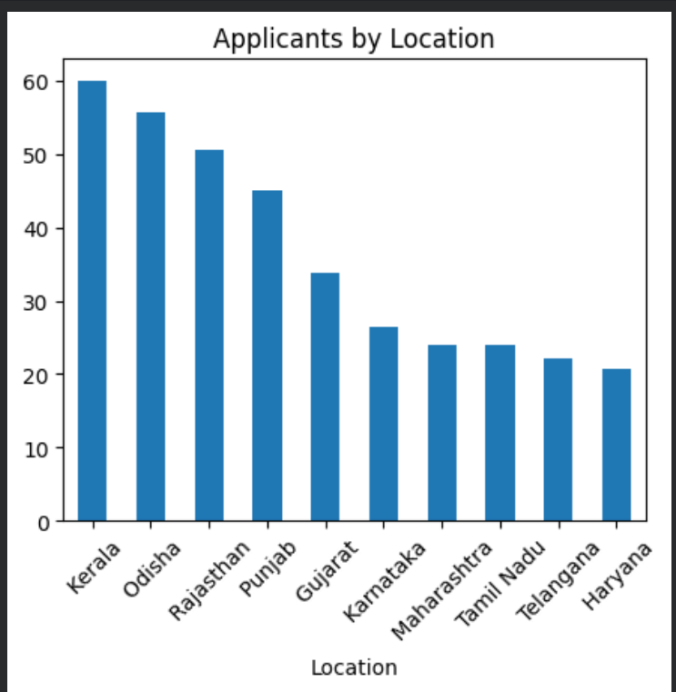
GRAPHS & ANALYSIS
Top Hiring Locations
----------------------------------
Explanation:
Shows cities with the highest number of job postings.
Bangalore, Hyderabad, and Pune lead in hiring.
Most opportunities are concentrated in tech hubs.
Key Insight: Job seekers should focus on these cities for better career opportunities.

Slide 6
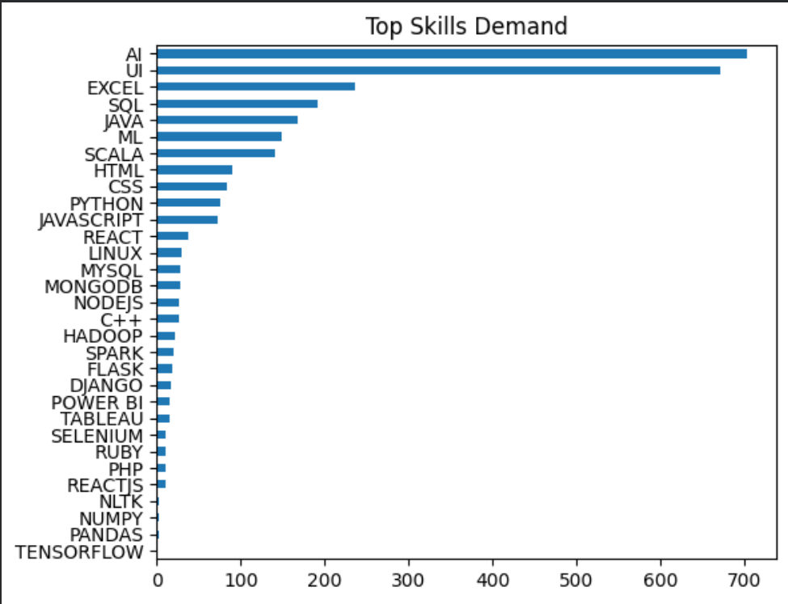
Most Demanded Skills
-------------------------------
Explanation:
Shows the most required skills in job postings.
AI and UI are highly demanded.
These skills are important in today's job market.
Key Insight: Learning these skills can increase job opportunities.

Slide 7
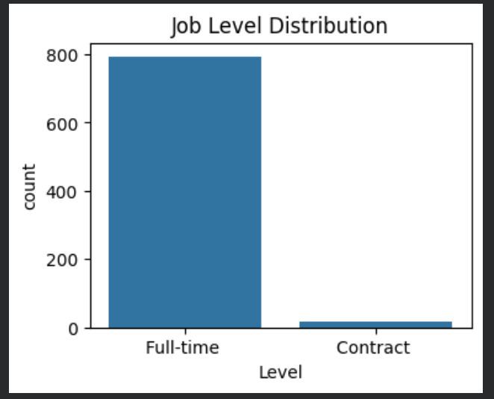
Job Level Distribution
--------------------------------------
Explanation:
Shows distribution of jobs across different levels
Majority of jobs are Full-time
Very few Contract roles → indicates companies prefer long-term hiring
Key Insight:
Most job openings are Full-time, showing strong demand for stable roles. Very few Contract jobs indicate limited short-term hiring.

Slide 8
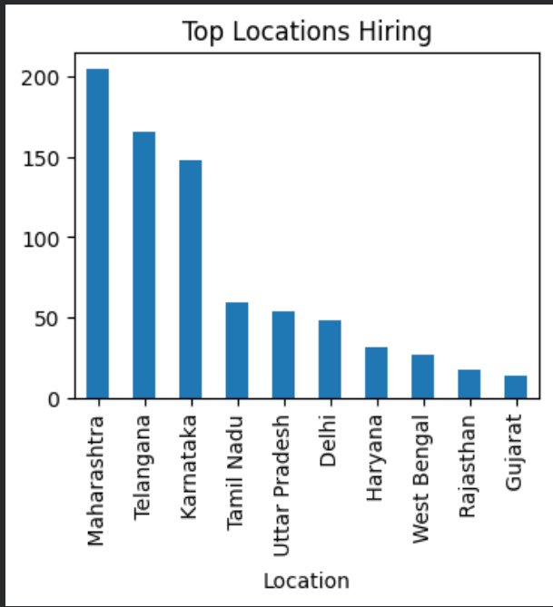
Top Hiring Locations
------------------------------------------
Explanation:
Shows top locations with highest job opportunities
Maharashtra, Telangana, and Karnataka have the most hiring
Key Insight:
Most jobs are in Maharashtra, Telangana, and Karnataka. These locations offer better career opportunities due to higher hiring demand.

Slide 9
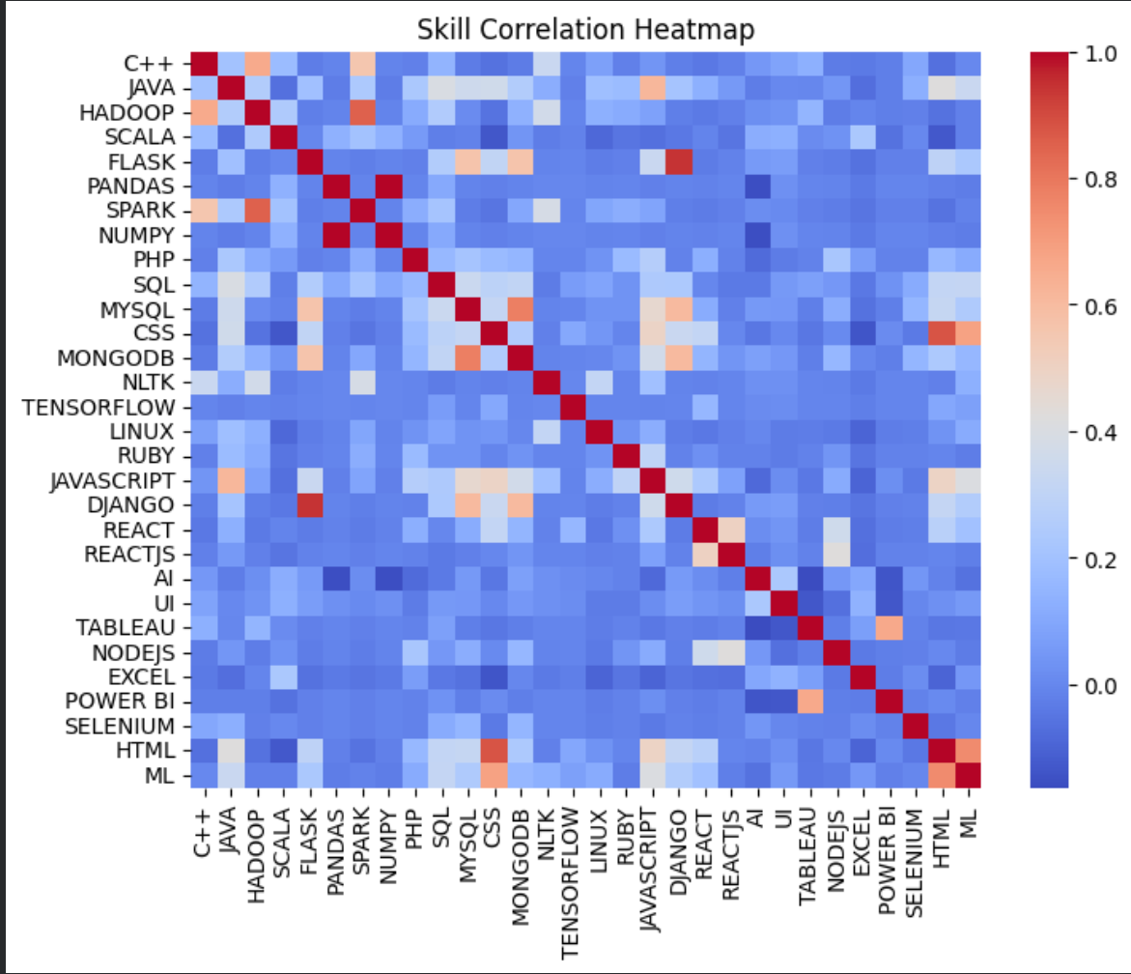
Skill Correlation Analysis
---------------------------------
Explanation:
This heatmap shows how often different technical skills are grouped together in job postings.
Stronger colour mean those skills are highly connected and frequently requested as a "package deal.
Key Insight:
To get hired, candidates must master interconnected "tech stacks" rather than learning tools in isolation.

Slide 10
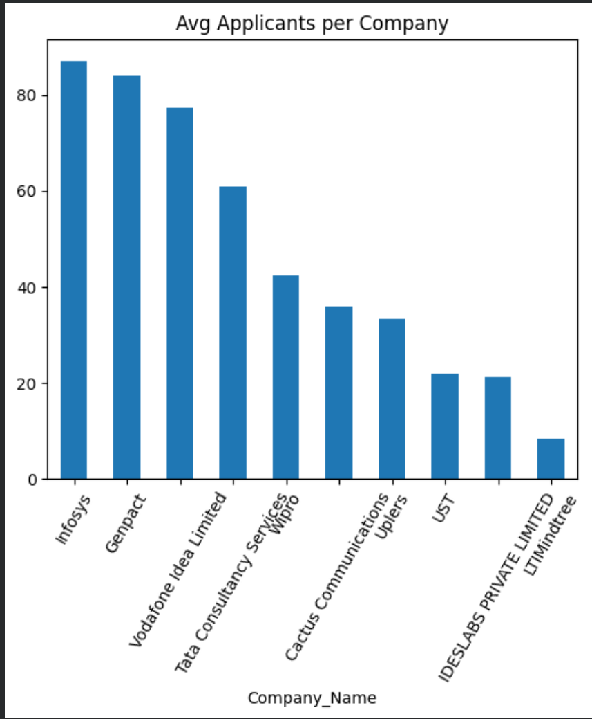
Average Applicants per Company
----------------------------------
Explanation:
Top Tier: Infosys and Genpact lead the group significantly, both averaging well over 80 applicants.
Lower Tier: The bottom half of the companies see average applicant numbers in the 20s and 30s, with LTIMindtree having the lowest average at under 10 applicants.
Key Insight:
Talent demand is highly concentrated among a few top brands. Smaller firms face a clear visibility and attraction gap.

Slide 11
Most jobs are full-time:
IT services and consulting companies are doing the most hiring.
Top locations:
The best places to find tech jobs are Maharashtra, Karnataka, and Telangana.
AI and UI are must-haves:
Over 80% of job postings ask for Artificial Intelligence and UI Design skills.
Mix your skills:
Employers want a combination of tools (like knowing Python along with SQL or Excel), not just one single skill.
High competition:
Big companies (like TCS and Wipro) post the most jobs, but they get a lot of applicants—about 23 per job.
Stand out with special skills:
Knowing advanced topics like Machine Learning or AI is the best way to beat the competition and get hired.
Conclusion:

